Slide 1
PREVENTING MONITORING
of the
Erasmus+ CBHE Project International Students Adaptation and Integration/ INTERADIS 619451-EPP-1-2020-1-NL-EPPKA2-CBHE-JP
NATIONAL UNIVERSITY OF WATER
AND ENVIRONMENTAL ENGINEERING
Kharkiv 01, October 2021

Slide 2
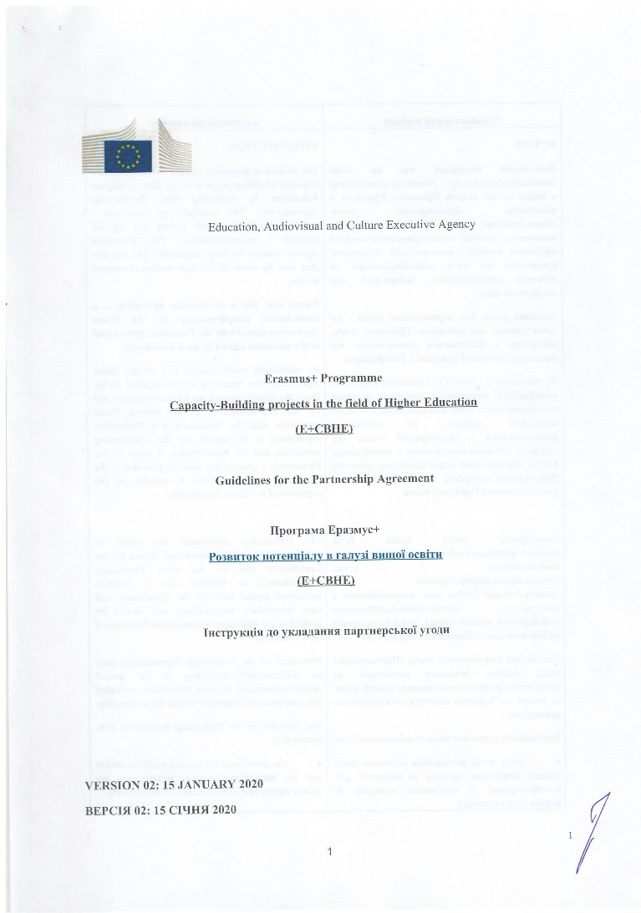
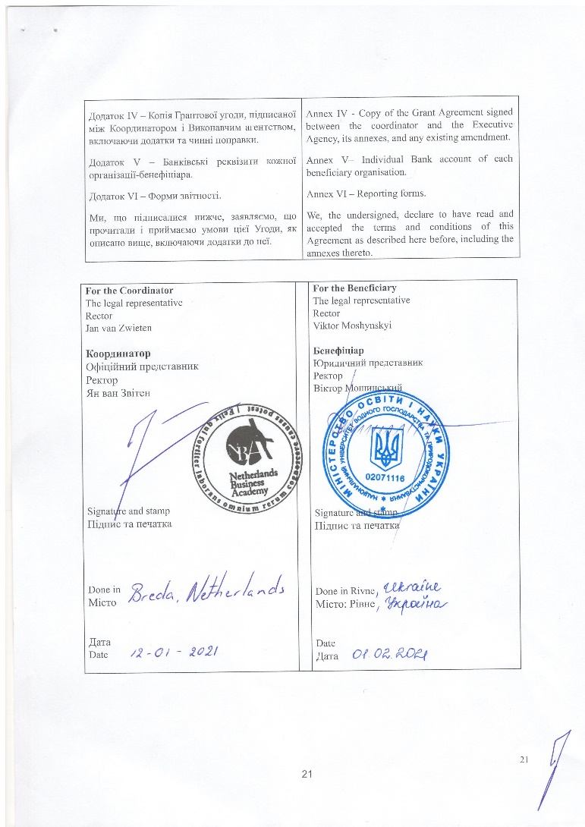
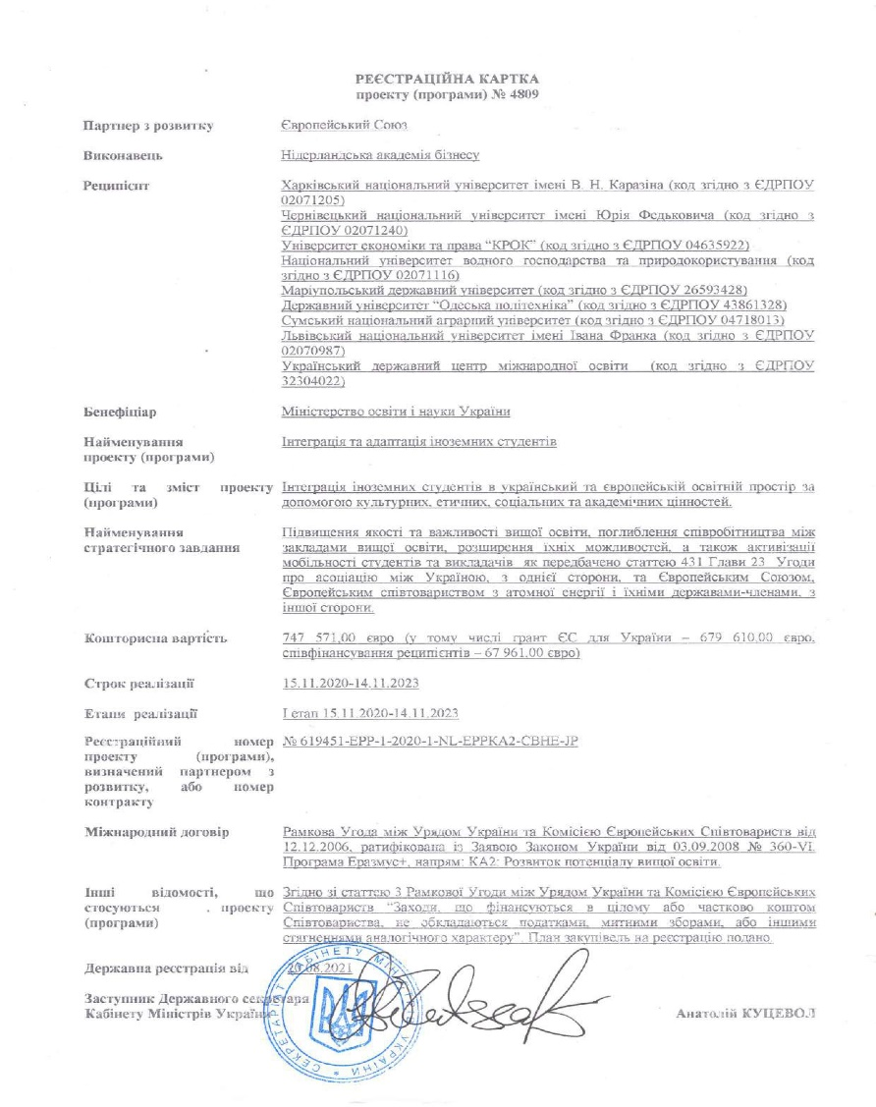
PROJECT IMPLEMENTATION.
DELIVERABLES COMPLETED
Project State registration No 4809
from August 20, 2021
Partnership Agreement ( February 01, 2021)
Notes:
‹#›

Slide 3
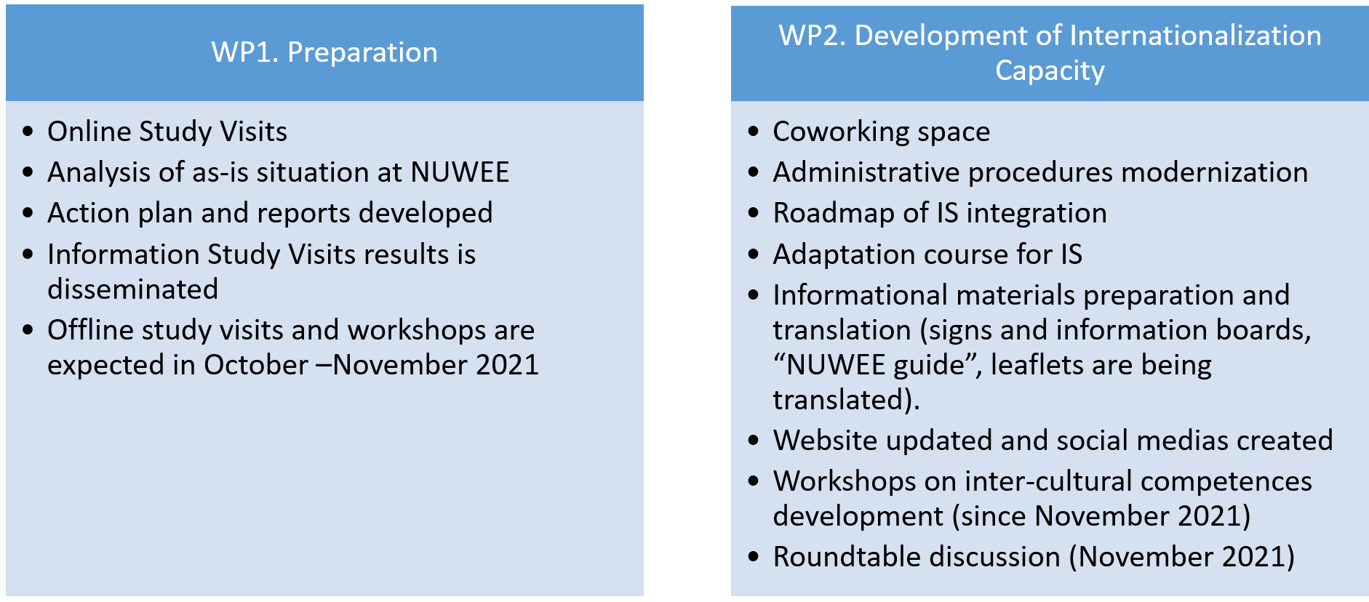
PROJECT IMPLEMENTATION.
DELIVERABLES COMPLETED
Notes:
‹#›

Slide 4
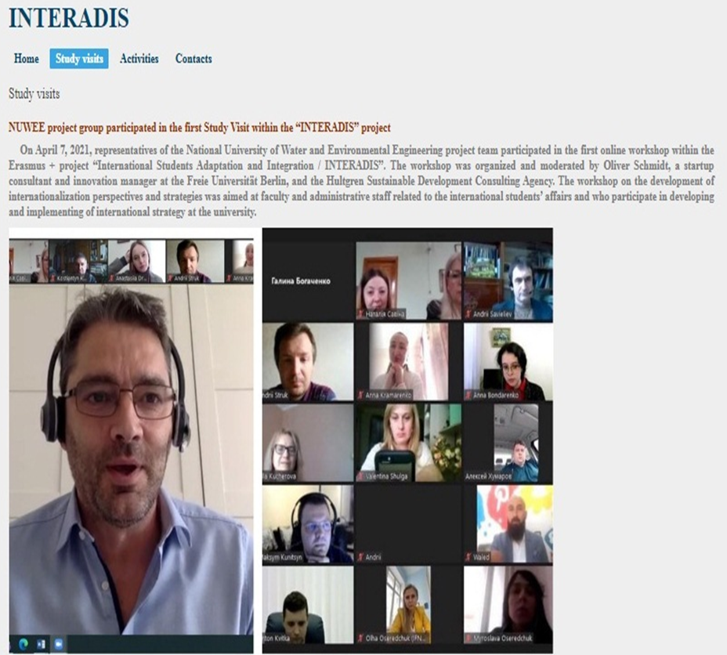
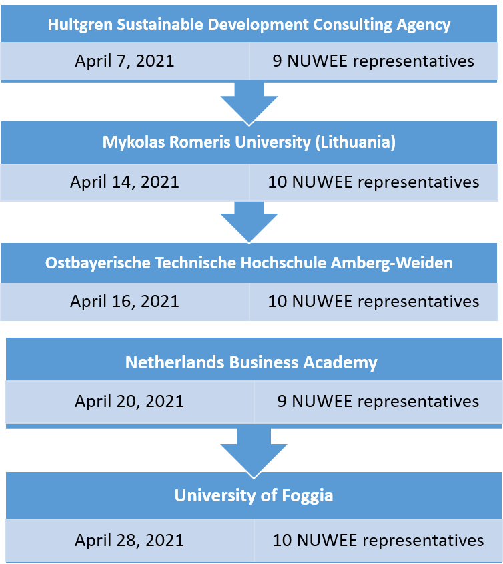
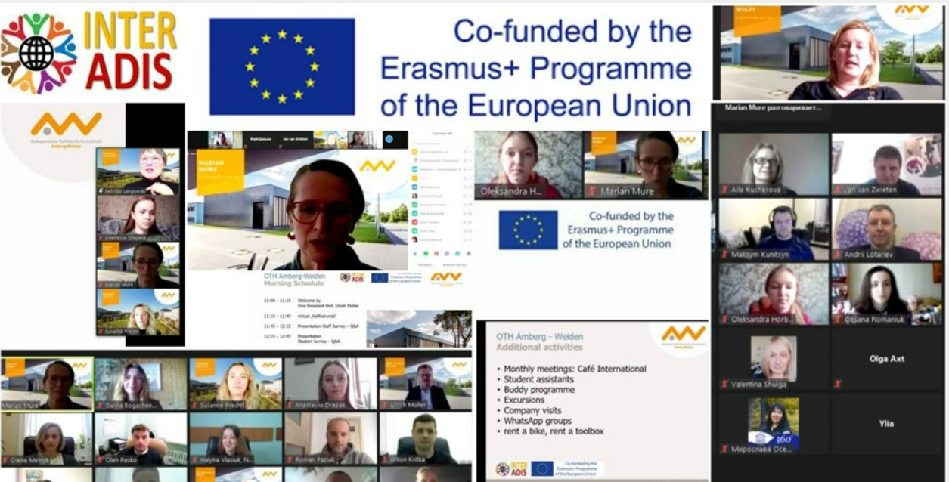
PROJECT IMPLEMENTATION. DELIVERABLES COMPLETED
Online Study Visits
Notes:
‹#›

Slide 5
PROJECT IMPLEMENTATION.
Quality Management
WP 5 Owner. Hultgren Nachhaltigkeitsberatung UG, Germany
NUWEE quality management
To assure the quality of the INTERADIS project activities and results the quality management group was initiated:
Vice-rector for Administrative Affairs,
Director of the Institute of Economics and Management, Head of Department for Didactics,
Head of Education Quality Department,
2 Ukrainian students and 2 International students from Morocco and Ecuador,
The quality of educational materials is assured by the guarantors of the relevant specialties.
Quality plan developed.
Evaluation and quality control of the SV, trainings, project events, etc.
Evaluation of the achieved results.
Ongoing quality control.
Advising and supporting the project management and WP owners
Notes:
‹#›

Slide 6
Project visibility. Website
(art. 1.10.8-9 Grant agreement)
To disseminate the information on the project the tab “INTERADIS” on the NUWEE home page and the tab “INTERADIS” on the webpage of the Centre for International Cooperation and Education in Ukrainian, English and Russian languages was created
Project logo and logos for project beneficiaries are used on the webpage and all project publications
https://nuwm.edu.ua/
PROJECTS
INTERADIS
https://inter.nuwm.edu.ua/en/interadisen
INTERADIS
Notes:
‹#›

Slide 7
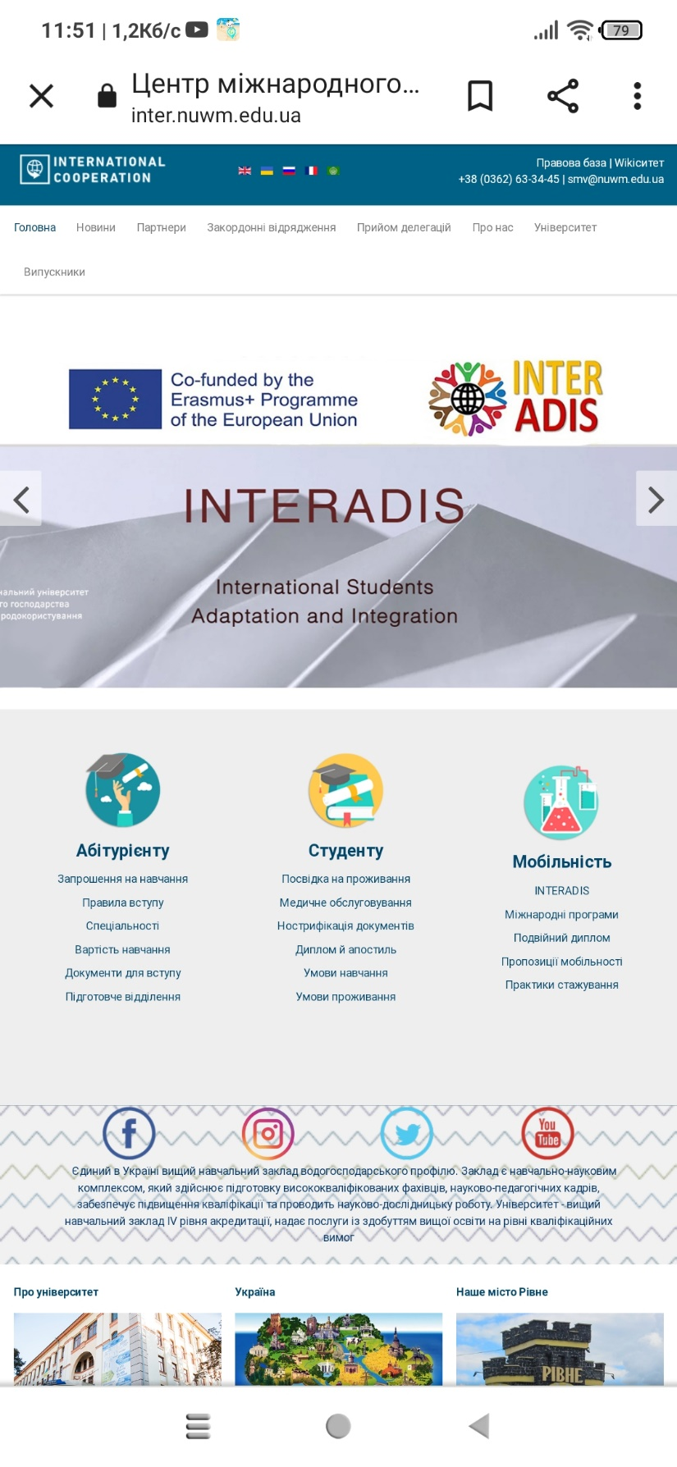
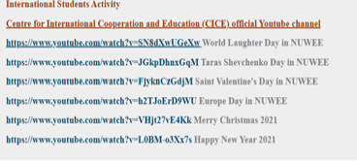
Project visibility. Website
(art. 1.10.8-9 Grant agreement)
The tab "INTERADIS" includes
Home (project description, work packages, NUWEE project group)
Study visits (analysis of European practices and University activity to improve administrative procedures, quality of education, integration and adaptation of international students in NUWEE)
Activities (dissemination of training results from European project partners on the university website, CICE, social networks, newspaper "Rivne Info“ posts; International students activities aimed at integration into the Ukrainian academic and sociocultural environment - International Students Activity - in particular: at the Center for International Cooperation and Education (CICE) official Youtube channel; author's project of coworking space; etc.)
Contacts
Notes:
‹#›

Slide 8
Dissemination
News on SV 1 HUG | https://en.nuwm.edu.ua/university-news/35-university-news/nuwee-project-group-participated-in-the-first-study-visit-within-the-interadis-project https://nuwm.edu.ua/university/news/nov2021040131121 https://inter.nuwm.edu.ua/en/news-en/7-latest-news/291-nuwee-project-group-participated-in-the-first-study-visit-within-the-interadis-project https://inter.nuwm.edu.ua/ua/newsua/1-latest-news-ua/281-uchast-proektnoi-hrupy-nuvhp-u-pershomu-seminaripraktykumi-u-ramkakh-proektu-interadis https://inter.nuwm.edu.ua/ru/newsru/6-latest-news-ru/286-uchastie-proektnoj-gruppy-nuvkhp-v-pervom-seminare-praktikume-v-ramkakh-proekta-interadis https://www.facebook.com/www.nuwm.edu.ua/posts/1847731285402739 https://www.facebook.com/permalink.php?story_fbid=1570305459834368&id=471092476422344 https://www.facebook.com/groups/435056830685228/permalink/846647909526116/ https://www.facebook.com/groups/893941677349973/permalink/3821320301278748/
Notes:
‹#›

Slide 9
Dissemination
News on SV 1 OTH Amberg Weiden | https://nuwm.edu.ua/university/news/nov202104191615 https://inter.nuwm.edu.ua/en/news-en/7-latest-news/297-study-visit-to-ostbayerische-technische-hochschule-amberg-weiden-within-the-interadis-project-implementation https://inter.nuwm.edu.ua/ua/newsua/1-latest-news-ua/295-seminar-vid-skhidnobavarskoho-tekhnichnoho-universytetu-amberhvaiden-v-ramkakh-realizatsii-proektu-interadis https://inter.nuwm.edu.ua/ru/newsru/6-latest-news-ru/296-seminar-ot-vostochno-bavarskogo-tekhnicheskogo-universiteta-amberg-vajden-v-ramkakh-realizatsii-proekta-interadis https://www.facebook.com/www.nuwm.edu.ua/posts/1852556161586918 https://www.facebook.com/permalink.php?story_fbid=1575023606029220&id=471092476422344 https://www.facebook.com/groups/435056830685228/permalink/848843362639904/
News on SV 2 MRU | https://nuwm.edu.ua/university/news/nov202104151845 https://inter.nuwm.edu.ua/en/news-en/7-latest-news/294-online-studying-within-the-interadis-project-continues https://inter.nuwm.edu.ua/ua/newsua/1-latest-news-ua/292-onlain-navchannia-v-ramkakh-proektu-interadis-tryvaie https://inter.nuwm.edu.ua/ru/newsru/6-latest-news-ru/293-onlajn-obuchenie-v-ramkakh-proekta-interadis-prodolzhaetsya https://www.facebook.com/www.nuwm.edu.ua/posts/1849965055179362 https://www.facebook.com/www.nuwm.edu.ua/posts/1849805891861945 https://www.facebook.com/permalink.php?story_fbid=1572409459623968&id=471092476422344
Notes:
‹#›

Slide 10
Dissemination
News on SV 4 NLBA | https://nuwm.edu.ua/university/news/nov202104221451 https://inter.nuwm.edu.ua/en/news-en/7-latest-news/300-workshop-introduction-to-intercultural-communication-by-netherlands-business-academy-within-the-framework-of-interadis-project https://inter.nuwm.edu.ua/ua/newsua/1-latest-news-ua/298-navchalnyi-treninh-vstup-do-mizhkulturnoi-komunikatsii-vid-niderlandskoi-biznesakademii-u-v-ramkakh-proektu-interadis https://inter.nuwm.edu.ua/ru/newsru/6-latest-news-ru/299-obuchayushchij-trening-vvedenie-v-mezhkulturnuyu-kommunikatsiyu-ot-niderlandskoj-biznes-akademii-v-ramkakh-proekta-interadis https://www.facebook.com/www.nuwm.edu.ua/posts/1854667471375787 https://www.facebook.com/www.nuwm.edu.ua/posts/1854680694707798 https://www.facebook.com/permalink.php?story_fbid=1576773949187519&id=471092476422344 https://www.facebook.com/groups/893941677349973/permalink/3848278045249640/ https://www.facebook.com/groups/4842619652/permalink/10159617381484653/
News on SV 5 UNIFG | https://nuwm.edu.ua/university/news/nov202104291315 https://inter.nuwm.edu.ua/en/news-en/7-latest-news/303-best-practices-of-university-of-foggia-in-adaptation-of-international-students-within-the-framework-of-interadis-project https://inter.nuwm.edu.ua/ua/newsua/1-latest-news-ua/301-dosvid-universytetu-fodzha-z-adaptatsii-inozemnykh-studentiv-u-ramkakh-proektu-interadis https://inter.nuwm.edu.ua/ru/newsru/6-latest-news-ru/302-opyt-universiteta-fodzha-po-adaptatsii-inostrannykh-studentov-v-ramkakh-proekta-interadis https://www.facebook.com/www.nuwm.edu.ua/posts/1859435904232277 https://www.facebook.com/www.nuwm.edu.ua/posts/1859802037528997 https://www.facebook.com/permalink.php?story_fbid=1581027198762194&id=471092476422344
Notes:
‹#›

Slide 11
Dissemination
NUWEE local activities Integration Activities | https://nuwm.edu.ua/university/ads/nov202108040842 https://nuwm.edu.ua/university/news/nov202010271158 https://www.facebook.com/permalink.php?story_fbid=1377667872431462&id=471092476422344 https://www.facebook.com/www.nuwm.edu.ua/photos/1844192839089917/ https://www.facebook.com/www.nuwm.edu.ua/photos/1715702348605634/ https://www.facebook.com/www.nuwm.edu.ua/posts/1839555926220275 https://www.facebook.com/www.nuwm.edu.ua/posts/1844192919089909 https://www.facebook.com/permalink.php?story_fbid=1567965413401706&id=471092476422344 https://www.facebook.com/permalink.php?story_fbid=1437432859788296&id=471092476422344 https://www.facebook.com/permalink.php?story_fbid=1546536502211264&id=471092476422344 https://www.facebook.com/permalink.php?story_fbid=1529049550626626&id=471092476422344 https://www.facebook.com/permalink.php?story_fbid=1529048533960061&id=471092476422344 https://www.facebook.com/permalink.php?story_fbid=1515457311985850&id=471092476422344 https://www.facebook.com/permalink.php?story_fbid=1495380537326861&id=471092476422344 https://www.facebook.com/permalink.php?story_fbid=1470664699798445&id=471092476422344
Notes:
‹#›

Slide 12
Dissemination. Integration activity
International Students Activity
Centre for International Cooperation and Education (CICE) official Youtube channel
https://www.youtube.com/watch?v=SN8dXwUGeXw World Laughter Day in NUWEE
https://www.youtube.com/watch?v=JGkpDhnxGqM Taras Shevchenko Day in NUWEE
https://www.youtube.com/watch?v=FjyknCzGdjM Saint Valentine's Day in NUWEE
https://www.youtube.com/watch?v=h2TJoErD9WU Europe Day in NUWEE
https://www.youtube.com/watch?v=VHjt27vE4Kk Merry Christmas 2021
https://www.youtube.com/watch?v=L0BM-o3Xx7s Happy New Year 2021
Notes:
‹#›

Slide 13
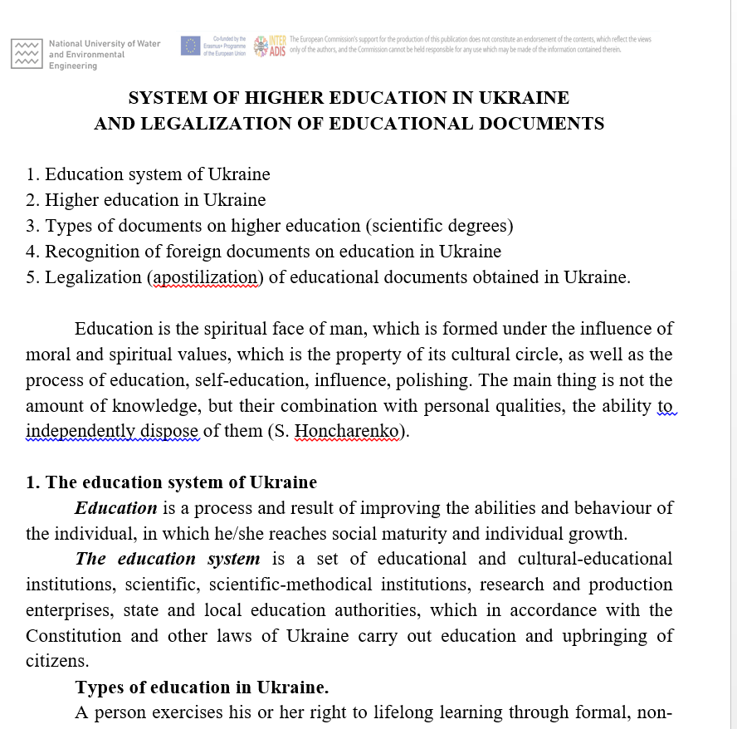
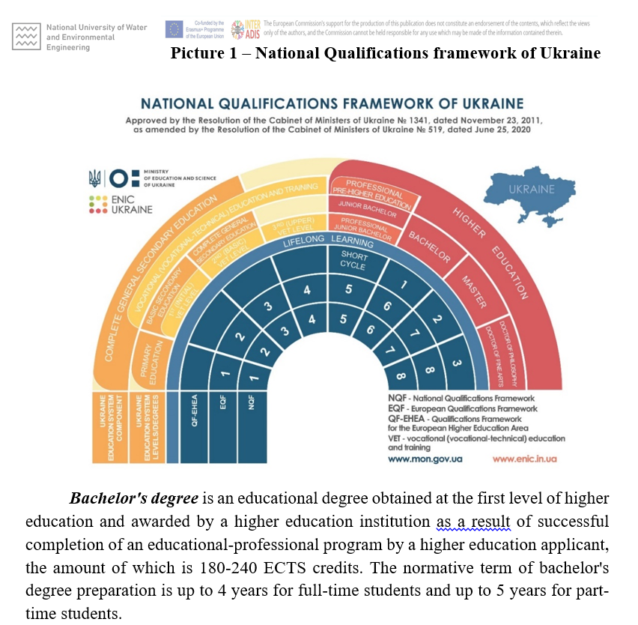
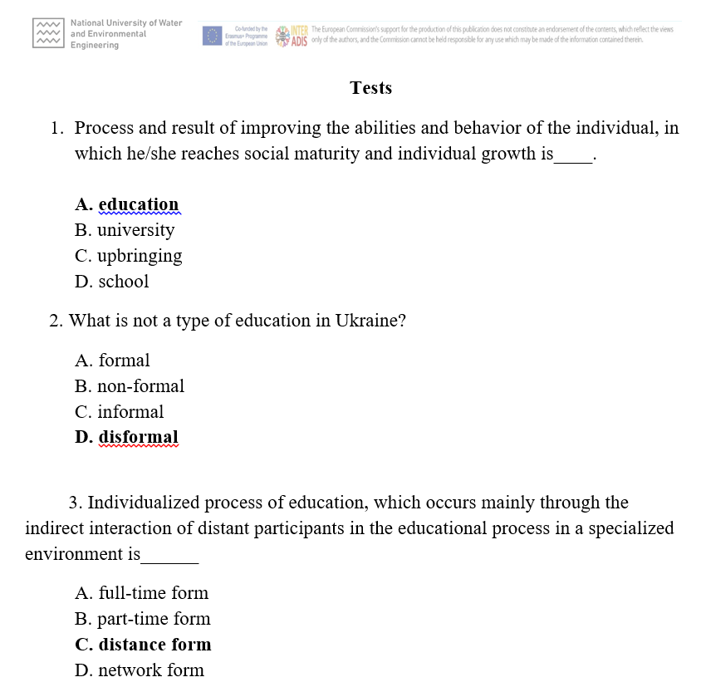
PROJECT IMPLEMENTATION
ADAPTATION COURSE DEVELOPMENT FOR IS
The Course chapter “SYSTEM OF HIGHER EDUCATION IN UKRAINE AND LEGALIZATION OF EDUCATIONAL DOCUMENTS" (prof. Nikitenko D.V., Lysiuk S.A.) has been developed. The running task is designing and producing video lectures.
Additional goal: modernization of the educational program in the specialty 076 " Business, Trade and Exchange Activities“ (language of training is English), based on Bologna principles: European Standards and Recommendations on Quality Assurance in the European Higher Education Area, European Network for Quality Assurance in Higher Education (ENQA), European Network of National Academic Recognition and Mobility Centers (ENIC), Network of National Academic Recognition Information Centers (NARIC), European Quality Assurance Register ( EQAR), etc., as well as lifelong learning tools.
Notes:
‹#›

Slide 14
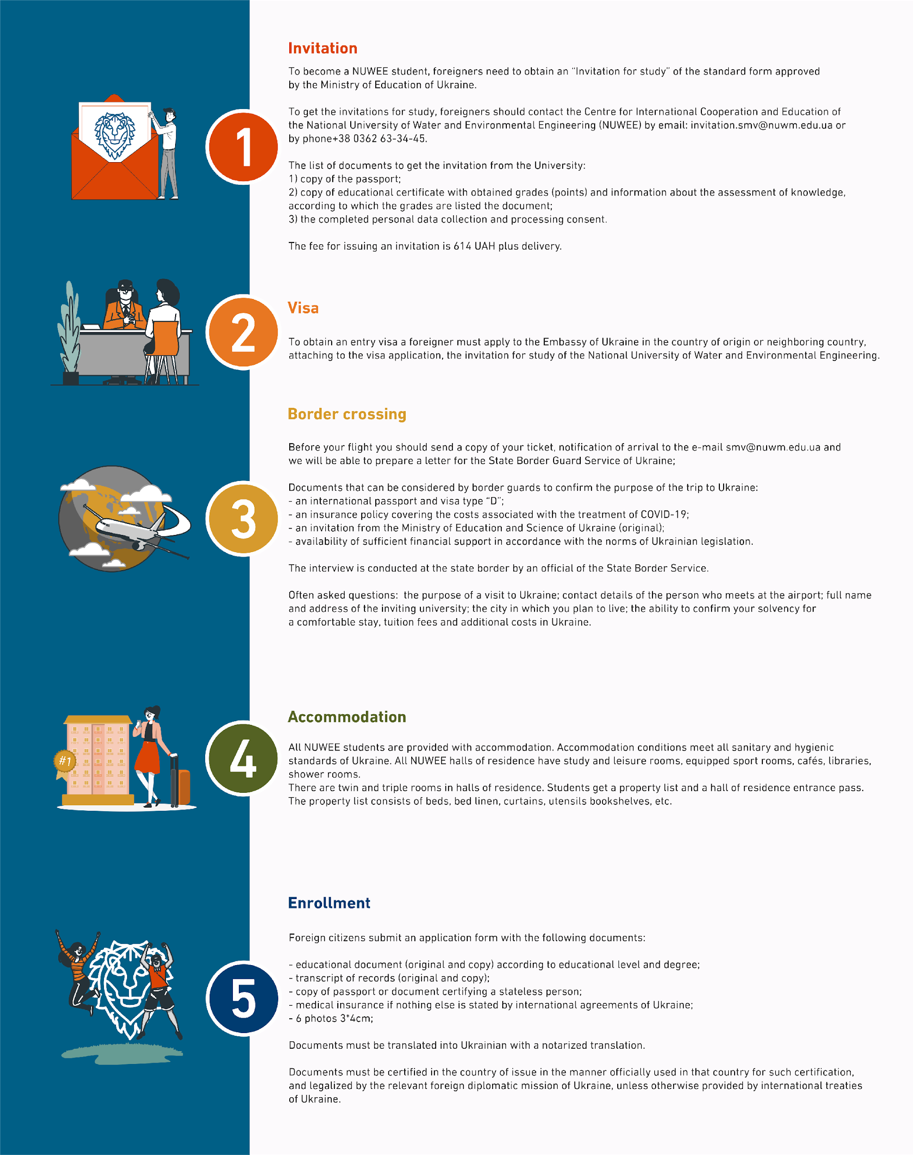
PROJECT IMPLEMENTATION
ROADMAP DEVELOPMENT FOR IS
The content of the Roadmap that includes all aspects of IS integration and adaptation is developed, data and information was collected and analyzed. Guidelines and useful information are prepared.
Design of Roadmap for IS and its adoption is in progress.
MODERNIZATION OF ADMINISTRATIVE PROCEDURES
The list of administrative procedures to be modernized:
Online application (online pre-application and online housing);
management of teaching-learning process in the language of instruction;
improvement the NUWEE legal framework regarding teaching-learning process of IS, marketing strategy, etc.;
introduction of Buddy programme
Notes:
‹#›

Slide 15
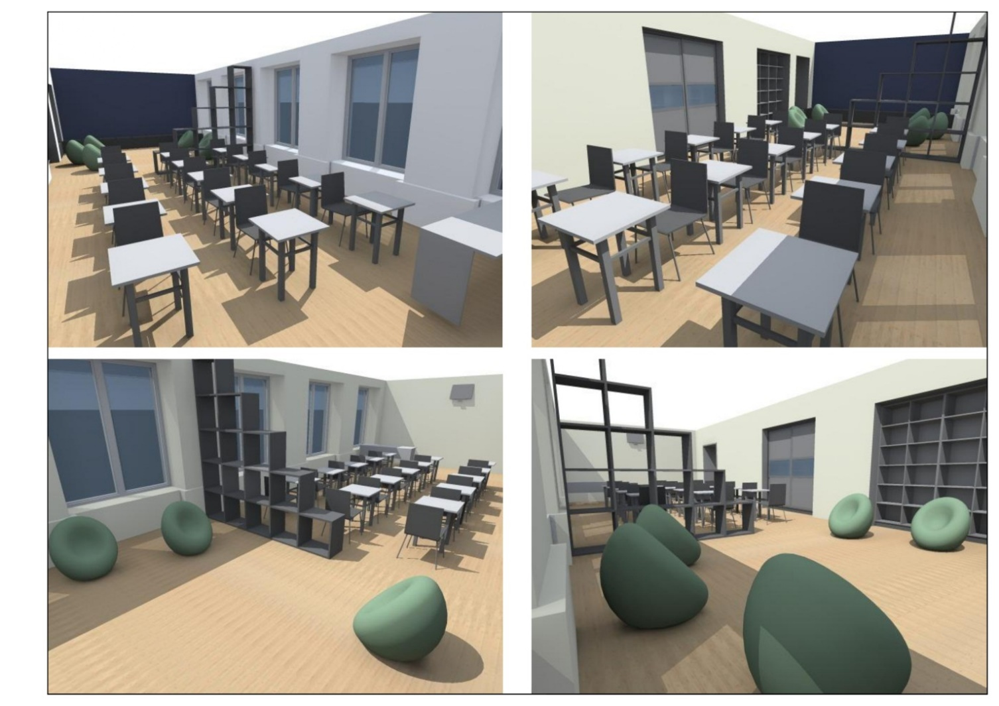
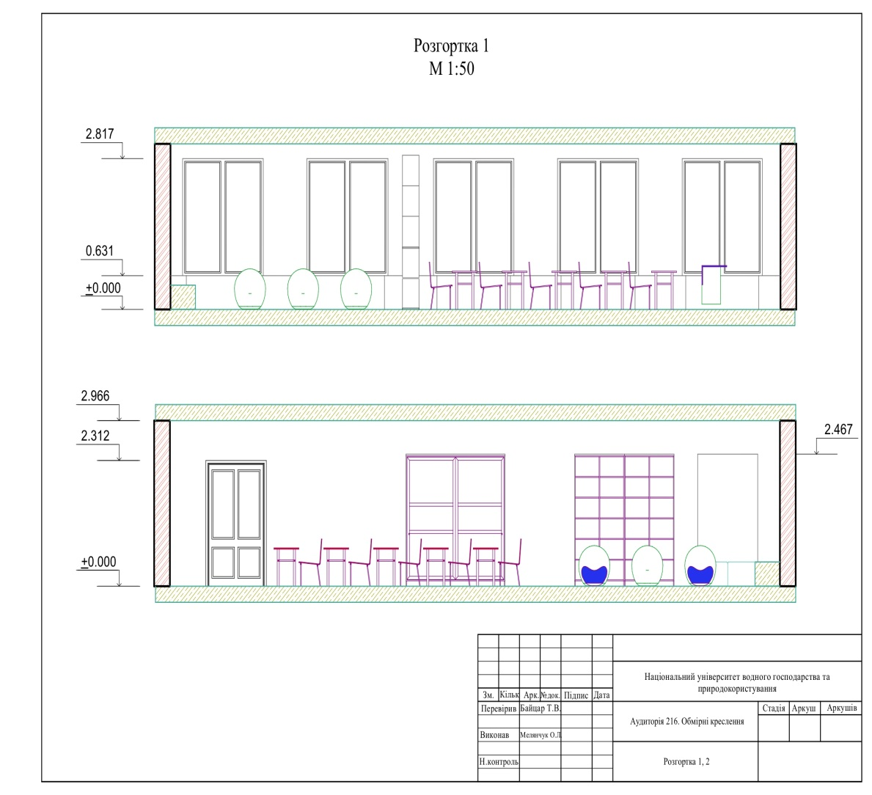
PROJECT IMPLEMENTATION
Coworking space
The author's project of a coworking space has been developed. Project supervisor: Ph.D. Baitsar Taras. Co-authors: Yakiv Hordiichuk, Ruslana Dubych, Arias Herrera Kevin Adrian, Ecuador (students of AM-31 group).
Notes:
‹#›

Slide 16
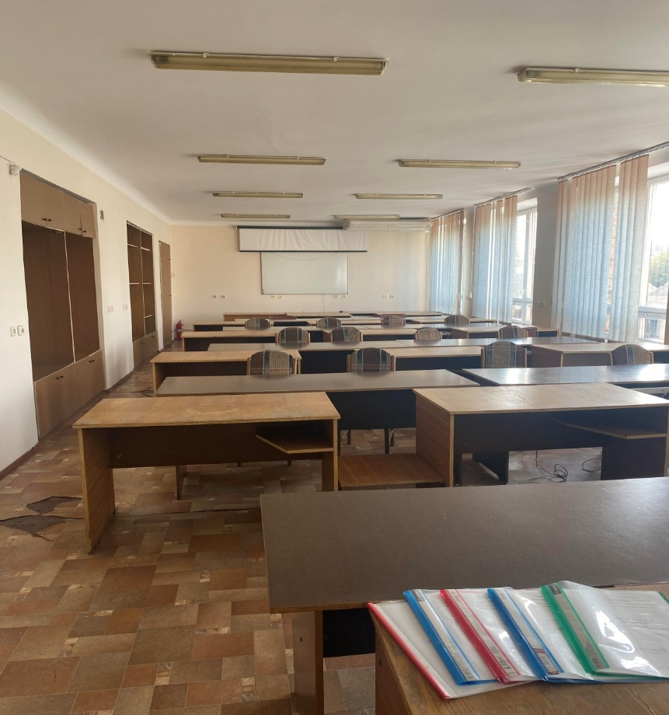
PROJECT IMPLEMENTATION
Coworking space
Space allocated for coworking Equipment to be purchased
before the renovation
Phases done: project idea developed, preparation of technical documentation and calculation, 3-d visualization, project state registration (exemption from VAT).
Processes in progress: place renovation, purchase of equipment.
The creative co-working space within INTERADIS project will ensure a modern space for various educational, scientific and joint socio-cultural activities of International students, Ukrainian students and other stakeholders.
laptop (6) with a licensed Windows system;
Multimedia projector;
Multifunction printer;
Wi-Fi Router;
portable screen;
magnetic (ceramic) whiteboard in an aluminium frame 200 × 100;
Flipcharts (2);
Video conferencing system for mid to large-sized meeting rooms;
Portable Tripod Monopod Kit & Ball Head for Camera.
Notes:
‹#›

Slide 17
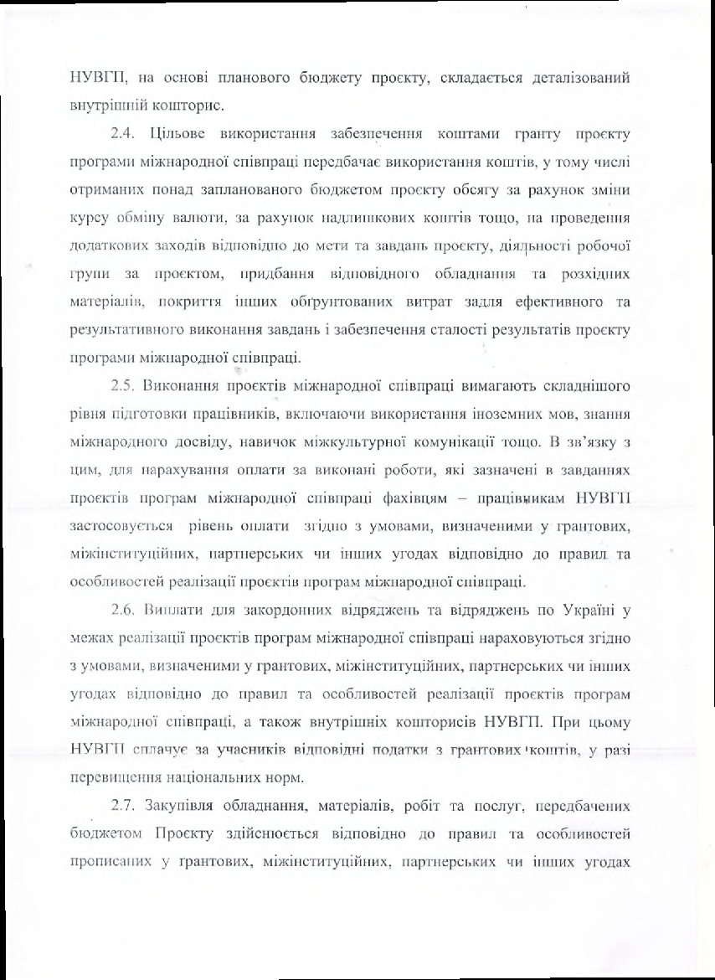
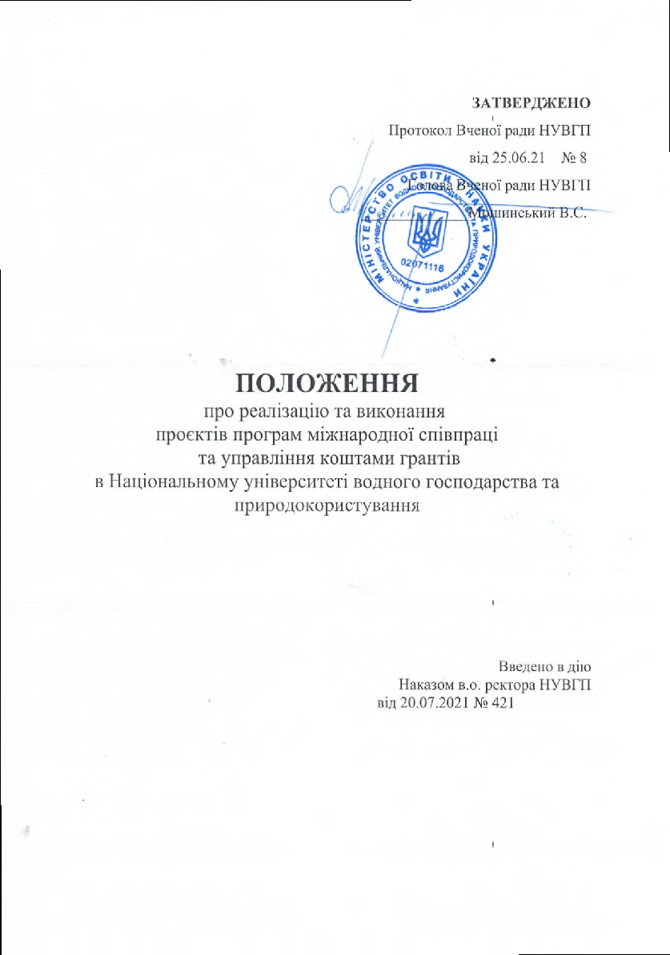
PROJECT FINANCIAL MANAGEMENT
https://bit.ly/3CEfhNN
Overal NUWEE budget within the project: 76215 Euro
Equipment: 10000 Euro
Staff cost: 19265 Euro
Travel cost: 13670 Euro
Cost of stay: 31780 Euro
Subcontracting costs: 1500 Euro
Departments involved in project financial management: Accountant Department, Finance & Planning Department, Personnel Department
Notes:
‹#›

Slide 18
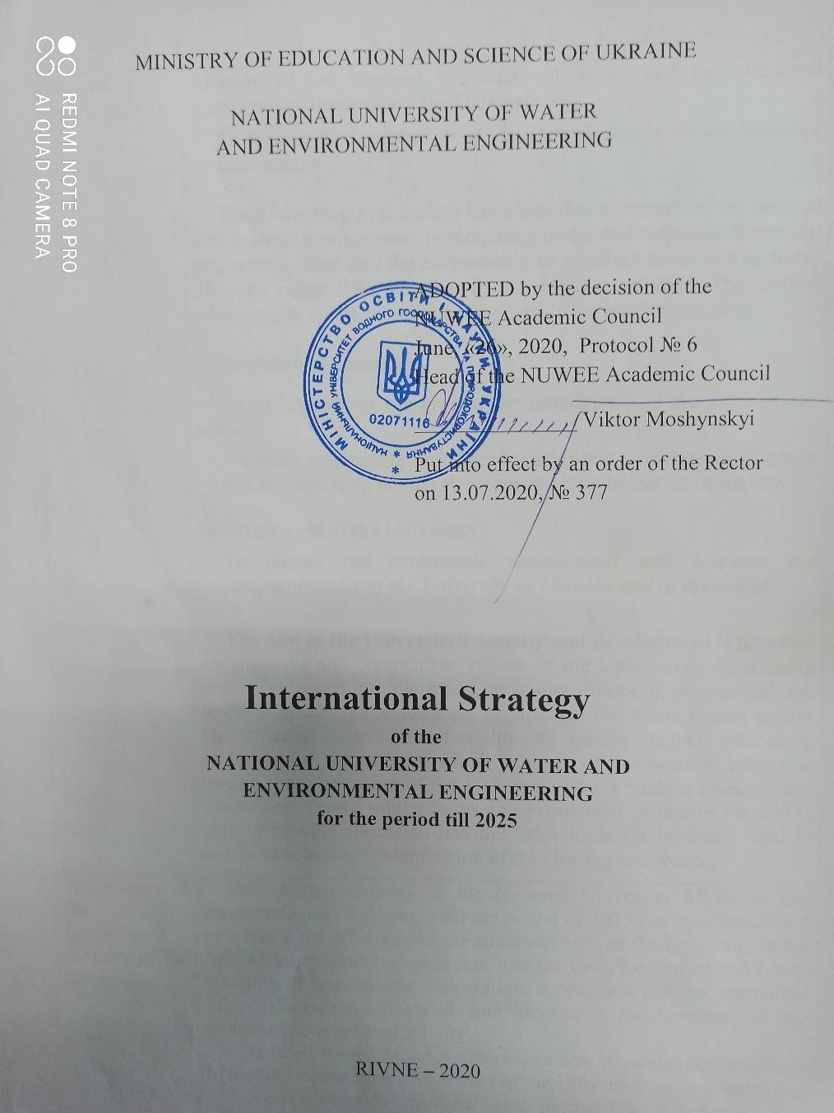
SUSTAINABILITY OF PROJECT RESULTS
INTERNATIONALIZATION
Expected results after project implementation:
adaptation of the NUWEE marketing strategy for the promotion of educational services on the international markets;
improved application and recruitment strategy of international students and ensuring the quality of education;
expanding the range of additional educational services that can be provided to IS as well, as to Ukrainian students (research internships, master's internships, increased list of courses and "Bachelor" and "Master" programs in English, double degree programs, development of academic mobility, etc.);
improving knowledge of foreign languages ​​and, thus, expanding access to the quality international education;
establishing a platform for interactions within and outside the consortium in order to improve the quality of research and international research projects;
positive NUWEE image and higher education of Ukraine in general due to the high quality and comfort education .
INTERNATIONAL STRATEGY
Notes:
‹#›

Slide 19
SUSTAINABILITY OF PROJECT RESULTS
NUWEE submitted the project to the State Fund for Regional Development. Project №7689 / 21-e "Innovation Center for Competitive Economy, Tourism and Human Capital“.
The main goal of the project is development in the Rivne region of a competitive economy, tourism and human capital through cooperation with representatives of foreign business in the educational, cultural, social and educational-intellectual spheres.
Main events:
Creation of an Innovation Center for the development of competitive economy, tourism and human capital, on the basis foreign language courses, conversation clubs for comprehensive cultural integration will be organized; information support programs for foreign citizens and academic mobility programs will be implemented.
2. Creation of an online platform of interactions "Cross integration“.
3. Organization and holding of a business forum, broadcast and recording of which will be distributed on the Internet on the YouTube channel NUWEE; introduction of educational-consulting, social, cultural and educational-intellectual activities (cultural events, educational-consulting seminars, conferences and summer schools, etc).
Notes:
‹#›

Slide 20
NUWEE CURRENTLY RUNNING PROJECTS
Visegrad-Water-Security
More info on projects: https://bit.ly/3zDkvrb
Notes:
‹#›

Slide 21
Thank You for attention!
Kharkiv 01, October 2021
Notes:
‹#›

